Slide 1

Maulana Azad National Institute of Technology , Bhopal (M.P) May 2022
Department of Mathematics & Computer Application
Project
PAR Debit Portfolio Application
Submitted To
Dr. Sujoy Das
Submitted By
Siddharth Sharma
192120079

Slide 2
Content
Introduction
Method Used for Development
Tools & Technology
User Interface
Conclusion

Slide 3
Introduction
PAR is a desktop application which is been used since 2001 and day by day it is getting feature loaded. PAR is a application which is used to manage the Debit portfolio of the fiserv. This application is used for onboarding the clients for fiserv who want to avail the debit services of fiserv STAR. This application manages the card for each and every client connected to fiserv

Slide 4

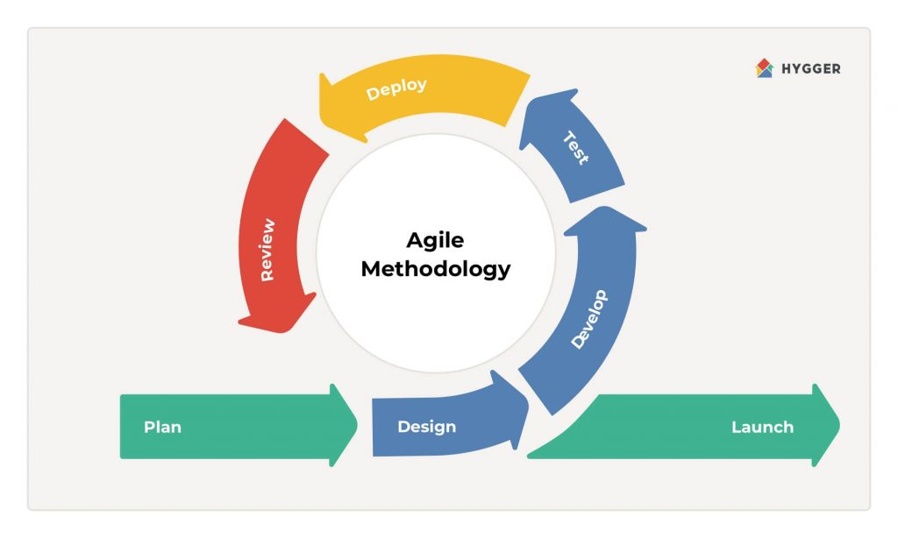



Method Used for Development

Slide 5
Tools & Technology
PLSQL Oracle
Power Builder
SQL Developer Application
Toad For Oracle
Git and puTTY

Slide 6
Objective :
• To manage all the Clients and Cards connected to them.
• Storing the information related to card.
• Handling the terminal of ATM.
• To minimize code and reduce time.
• To enhance the next release of application
• To get the clients onboarded
• Work on a large scale of DATABASE

Slide 7
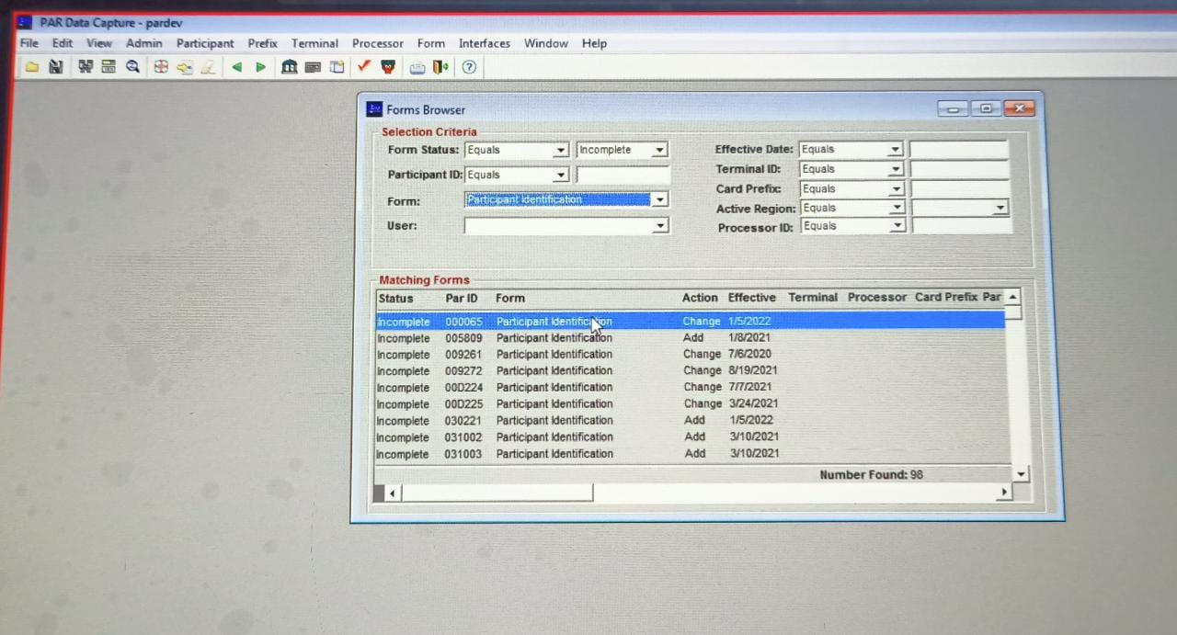
PAR Application

Slide 8
Main Components :
Participant : Enables the clients(Banks or financial institutions) to have a special edge for their payment department with the help of the payment gateway and terminal created by the fiserv clients can easily avail the benefit of digital transactions.
Prefix : It contains the information about the card service that how card needs to be taken into the consideration as per the terms and condition. From how a card needs to be created to where and how it will work.
Terminal : Fiserv also provide the terminal for cards that means it also provides the ATM/Card Machines inorder to initiate the transaction from the merchant end and will check the prefix and then will be transferred to terminal again for success or failure of transaction.

Slide 9
Conclusion
The PAR App is h high level Onboarding application for participants of fiserv and which is being upgraded on sprint basis in every 15 Days.
And being a developer we need to ensure that application is bug free and new features are available to be used at every update.

Slide 10
Thank
You !

